Slide 1

SMART INDIA HACKATHON 2026
TITLE PAGE
Problem Statement ID – 18
Problem Statement Title- Peer Learning Recommendation System
Theme- Education & Smart Learning
PS Category- Software
Team ID- 02
Team Name - Codesakhi

Slide 2

IDEA TITLE
Your Team Name
SOLUTION
To solve this problem, CodeSakhi has developed PeerMatch — a smart peer-learning platform that analyzes student portfolios and suggests the most suitable learning peer.
Mandatory Portfolio – Students must create a portfolio during sign-up with their skills, goals, projects, and interests.
AI Portfolio Analysis – AI analyzes the portfolio and suggests the best compatible peer.
Focused AI Chatbot – A dedicated chatbot for PeerMatch, learning, and recommendation-related questions.
Portfolio & Progress Update – Students can update their skills, projects, and achievements regularly.
MCQ Skill Assessment – MCQ-based assessments help evaluate skills and improve future recommendations.
  Problem Statement
Students often struggle not because learning resources are unavailable, but because they cannot easily find the right peer to learn from

Slide 3
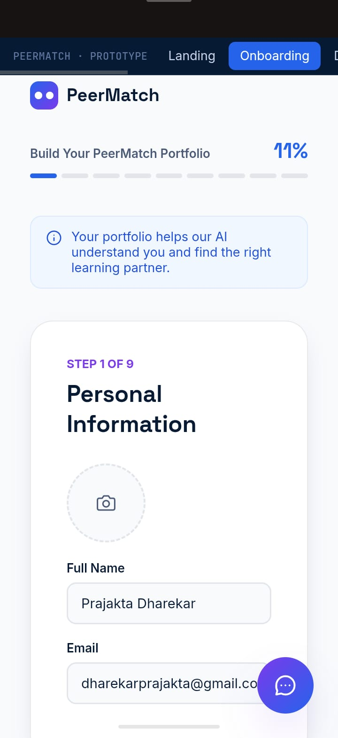
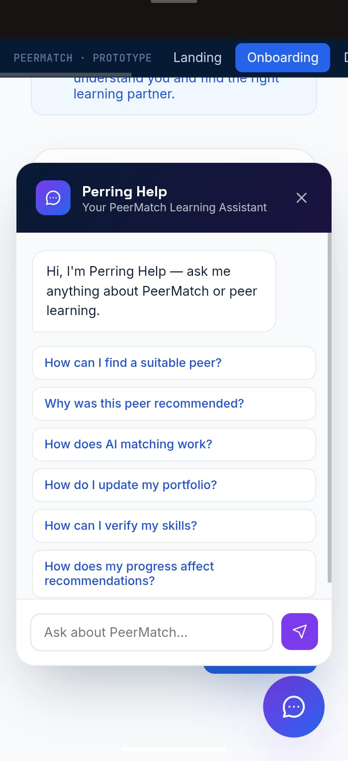
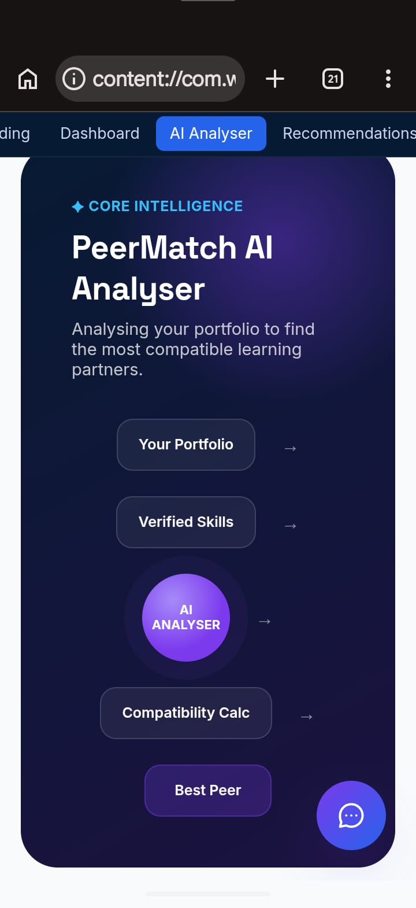
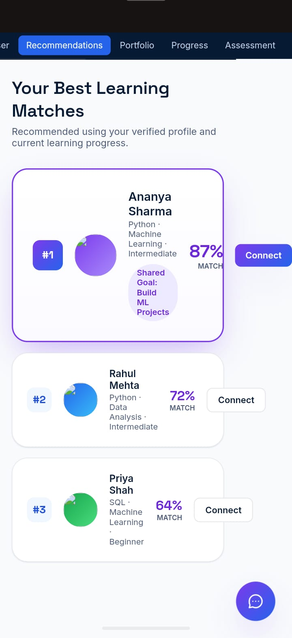
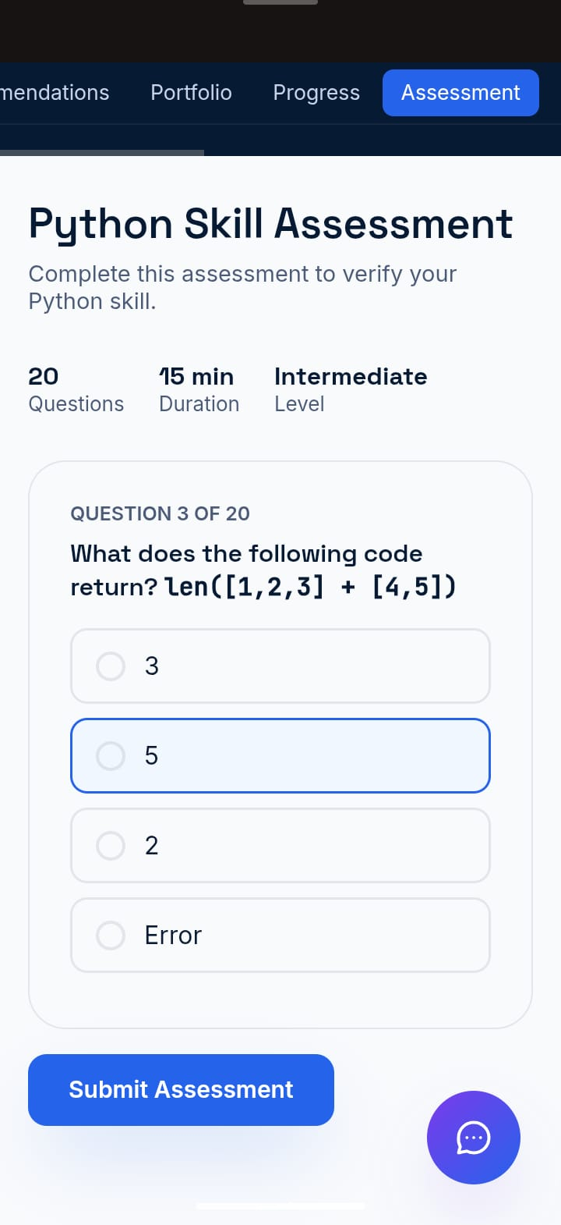
PROTOTYPE
Your Team Name

Slide 4
TECHNICAL APPROACH
Your Team Name
Frontend: HTML5, CSS & JavaScript – Simple, user-friendly interface.
Backend: Python FastAPI / Node.js – Handles data processing and application logic.
Database: PostgreSQL + pgvector – Stores student profiles and supports similarity matching.
Student Matching: Compares skills, interests & learning gaps to find suitable peers.
Assessment: MCQ-based tests to evaluate and verify student skills.
Chatbot: Provides instant guidance and PeerMatch support.

Slide 5
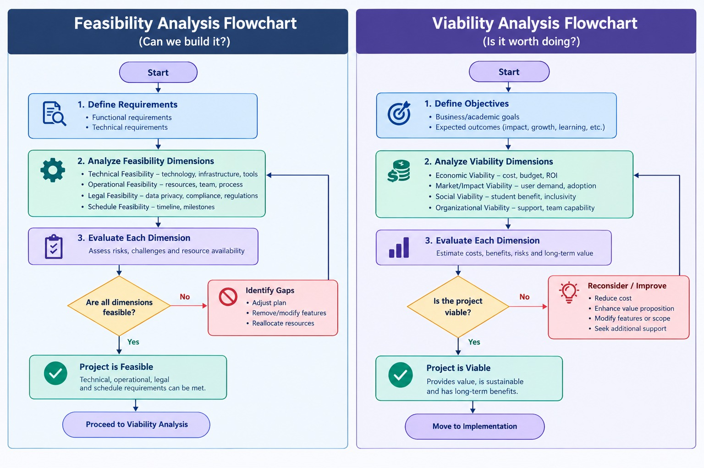
FEASIBILITY AND VIABILITY
Your Team Name
1. Feasibility of the Idea
Web-based system, accessible on mobile and basic PCs.
Uses available technologies like HTML, Python, PostgreSQL and JavaScript.
Easy to develop, maintain and scale.
2. Potential Challenges & Risks
New users may have limited profile information.
Students may try to cheat in skill assessments.
Student data and scores need privacy protection.
3. Strategies to Overcome Challenges
Onboarding Test: Quickly identifies the student’s initial skill level.
Anti-Cheating: Random questions and tab-switch detection.
Privacy: Keep personal scores private and show only verified skills.

Slide 6
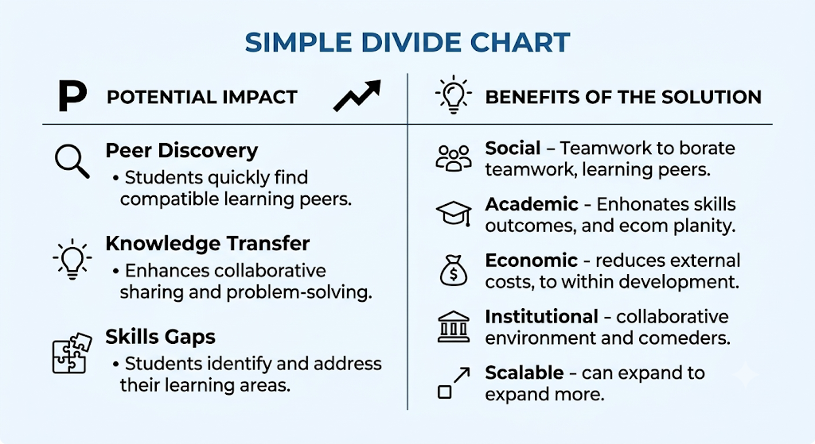
IMPACT AND BENEFITS
Your Team Name

Slide 7
RESEARCH AND REFERENCES
Your Team Name
Peer Learning Research: Topping (2005) – Peer learning supports collaboration, knowledge sharing and active learning.
Student Matching Research: Similarity-based methods can be used to identify students with compatible skills, interests and learning needs.
Assessment Research: MCQ-based assessments help evaluate and verify students’ knowledge and skill levels.
Technology References: PostgreSQL, pgvector, FastAPI, HTML, CSS and JavaScript were referred to for system development.
Future Integration: The system can be extended to integrate with college LMS platforms such as Moodle and Canvas.

Slide 8


